Slide 1




Department of Statistics
Marriage Choices and
Their Socio - Economic Effects
GROUP - 3 FIELD PROJECT

Slide 2

TEAM MEMBERS
  Mugdha Wagholikar-8266
  Aditi Khambe-8309
  Samruddhi Kulkarni-8272
  Vedika Pawar-8257
  Atharva Patil-8312
Mentor :
Miss. Rutuja Joshi Ma’am

Slide 3

LIST OF CONTENTS
  Introduction
  Methodology
  Objectives of the Study
  Graphs And Conclusions
  Reference

Slide 4
INTRODUCTION
Marriage, a universal institution, shapes families, communities, and economies. While traditionally essential for social acceptance and lineage, it is now increasingly influenced by education, financial independence, culture, and societal expectations. Marriage choices often balance emotional compatibility with financial stability, impacting relationships, household management, family welfare, and gender roles.

Slide 5

PROJECT OBJECTIVES
Assess preparedness, preferred family size, and factors influencing child-rearing decisions.
FAMILY & FINANCE
1
2
3
AGE & INDEPENDENCE
MARRIAGE & STABILITY
Study how financial independence and relationship status shift across life stages.
Evaluate the role of financial independence in marital stability, equality, and overall life choices.

Slide 6
METHODOLOGY
  Research Design : Survey-based, Descriptive & Analytical
  Structured questionnaire to explore marriage choices & socio-economic outcomes
  Study Area : Online survey → broader reach across Urban & Rural areas
  Ensures diversity in cultural & economic contexts
  Sample Size & Demographics (304 responses) :
Age: 18–60+ years
Gender : Male & Female
Marital Status : Unmarried, Married, Divorced, Widowed
Residence : Urban & Rural
  1) Data collection managed by Mugdha ,Vedika, Samruddhi , Aditi , Atharva
2) Data cleaning managed by Atharva
  Ethical Considerations : All ensured responses remained Anonymous & Confidential

Slide 7
METHODOLOGY
  Data Collection Tool: Google Form Questionnaire
  Steps We Conducted :
  Topic Selection
  Data collection And Cleaning
  Data Analytics (Demographic , Basic Statistics , Using Software’s)
  Visualization Of Results
  Interpretation And Conclusions
  Report Writing (Everyone)
  PPT making : Aditi ,Vedika, Atharva , Mugdha
  Software Used:
1. R Software (10 graphs) : Samruddhi & Mugdha
2. Python (5 graphs) : Atharva
3. MS Excel (10 graphs) : Aditi & Vedika
4. MS-word (Report writing) : Everyone
5. Canva

Slide 8

Graphs And Conclusion

Slide 9
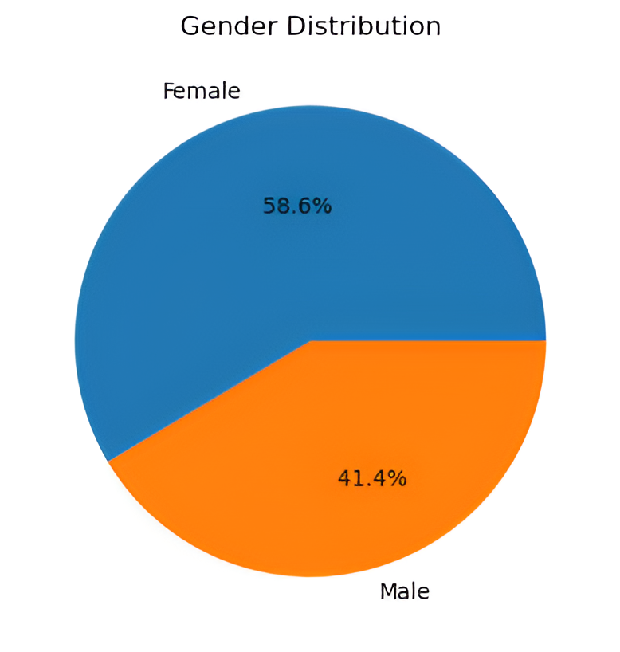
Male to Female ratio:
Female = 58.6% (178) ; Male = 41.4% (126)
Male: Female = (41.4 : 58.6) = 0.71 : 1
The gender distribution of the respondents shows that 58.6% (178) are female and 41.4% (126) are male, giving a Male-to-Female Ratio of approximately (0.71 : 1) . This indicates that the sample is slightly female dominated, which may influence the overall interpretation of marriage choice patterns in the study.

Slide 10
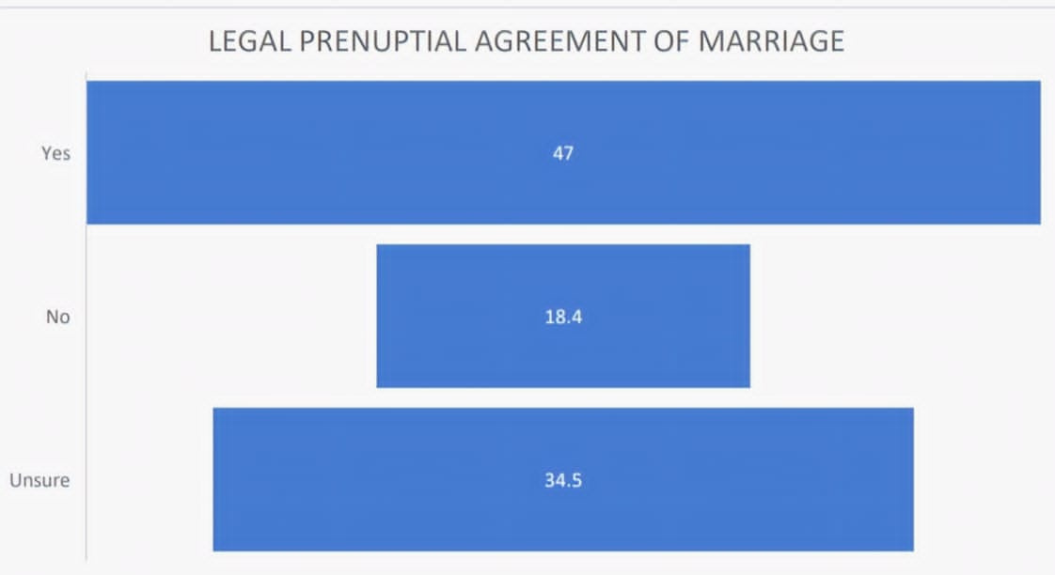
The majority (nearly half) are in favor of legal prenuptial agreements, indicating a growing acceptance of securing financial/legal clarity before marriage. However, a significant proportion (34.5%) remain unsure, reflecting hesitation or lack of awareness about the concept. Only a smaller share (18.4%) outright reject the idea.

Slide 11
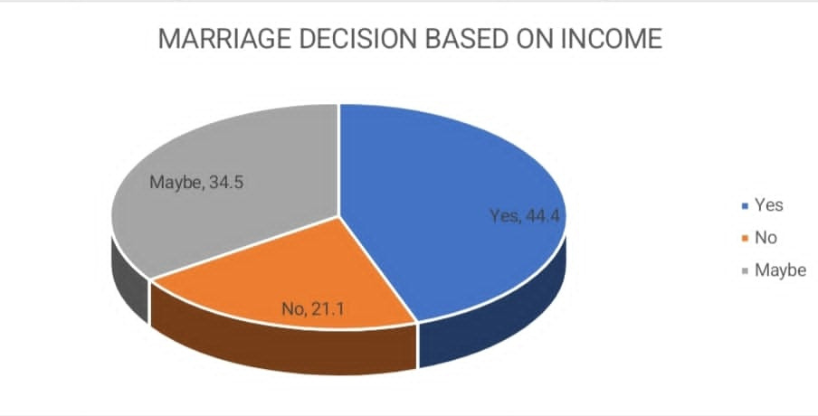
Majority of people consider income as a factor in their marriage decisions. Approximately 79% of respondents either believe income is a definitive "Yes" factor (44.4%) or a conditional "Maybe" factor (34.5%). Only a small minority (21.1%) consider income to have no influence on their decision to marry.

Slide 12
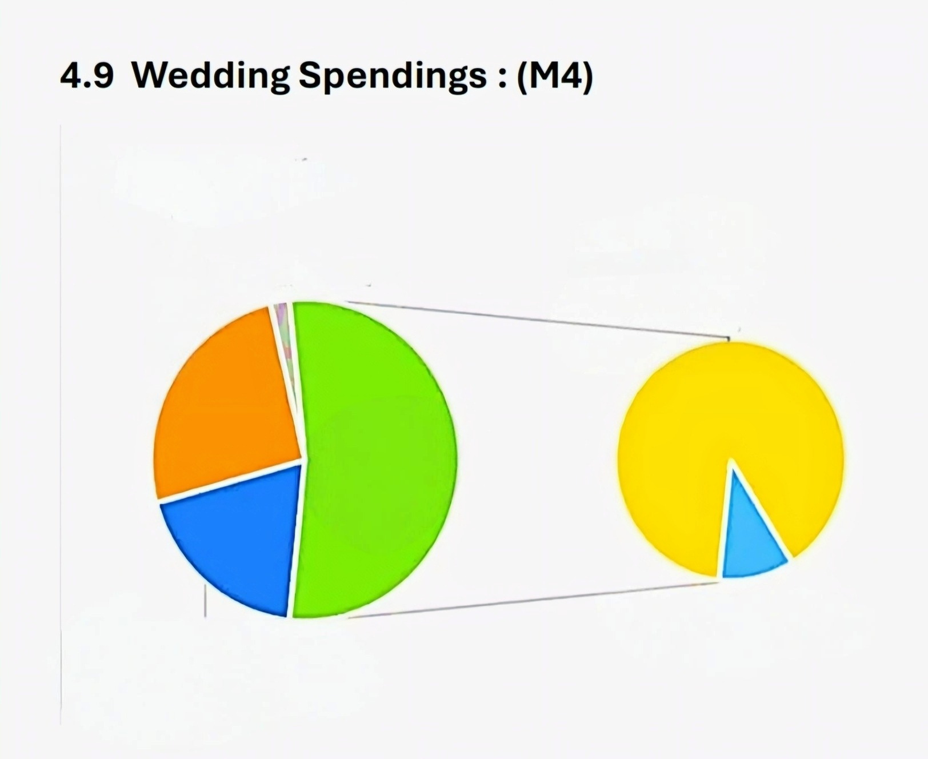
WEDDING SPENDINGS
Take a loan, 2%
Court marriage /Small scale
wedding, 48%
Half or more than half,
25.7%
Other
53%
Full amount saved for
marriage, 19%
Parents Money,
5%
Most people opt for small-scale/court marriages or . This reflects a growing preference for simpler and financially self-sufficient weddings. Rrather than spending more money for treditional marriage or following traditions.

Slide 13
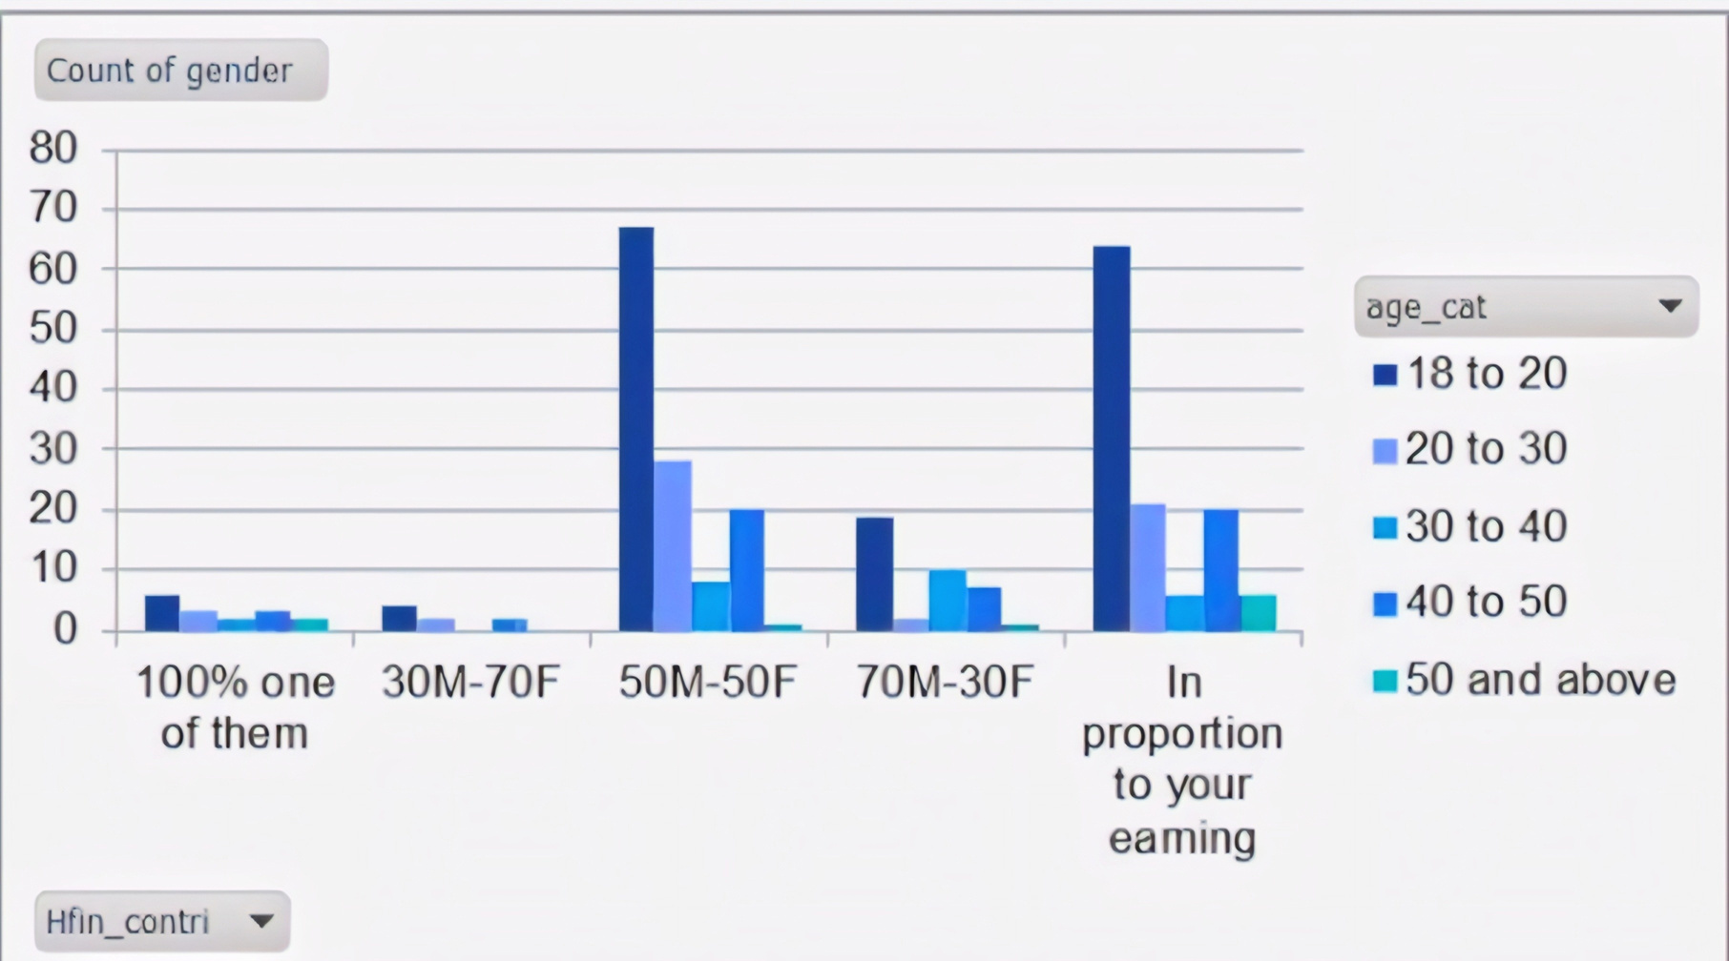
Household contribution Male(M) & Female(F)
The majority, especially among the younger generation (18–20), prefer equal financial contribution (50/50) or sharing in proportion to income, while traditional one-sided contribution models are far less favored. Youngsters are not supporting for one-sided contribution

Slide 14
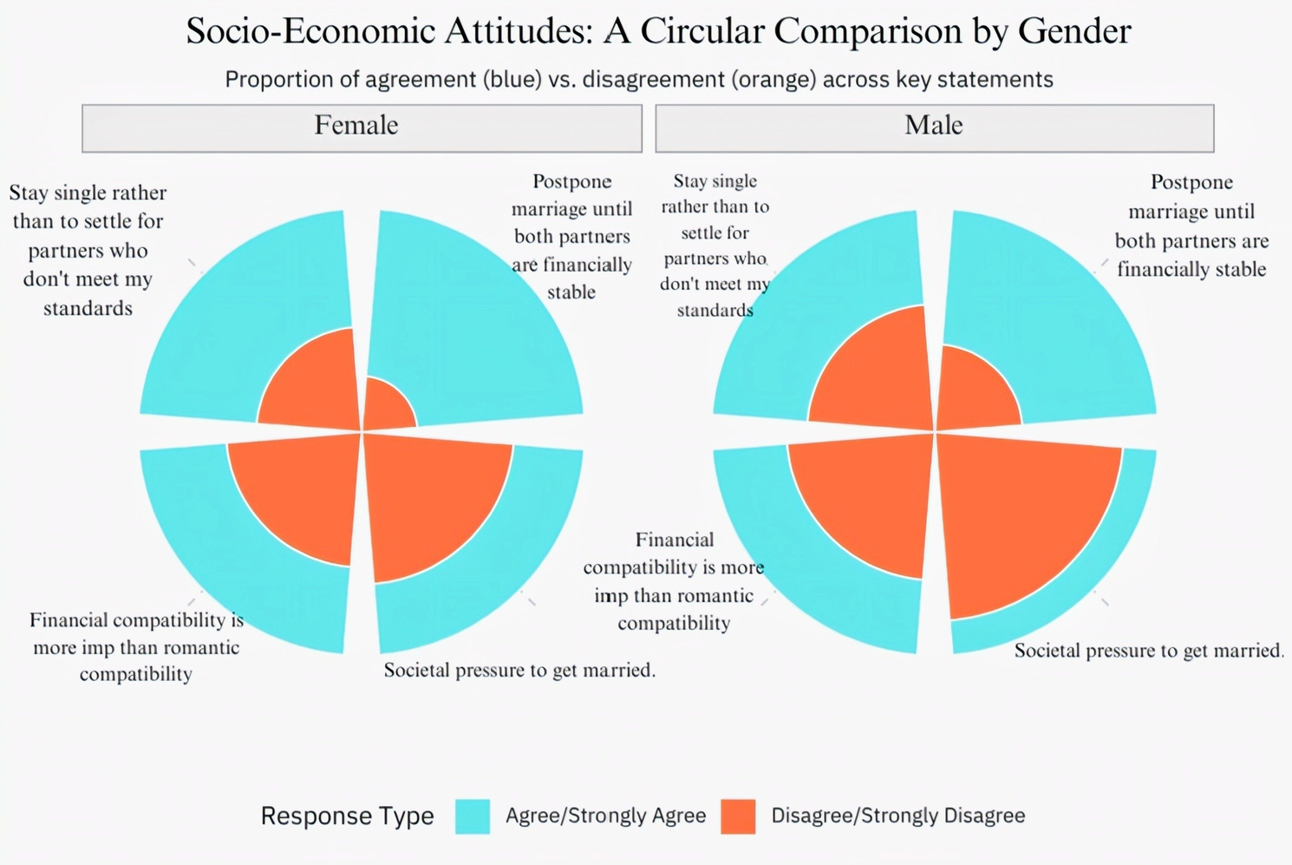
Female Trends
  Strong agreement with:
    Staying single rather than settling
    Postponing marriage until financially stable
  More agreement than men on financial compatibility being more important than romance
  Mixed views on societal pressure — some feel it, others don’t
Male Trends
  Also strong agreement with:
    Staying single rather than settling
    Postponing marriage until financially stable
  Less agreement than women on financial > romantic compatibility
  More likely to disagree with feeling societal pressure to marry
  Both genders strongly value standards and financial readiness before marriage.
  Women are more likely to prioritize financial compatibility over romance.
  Men are less likely to feel societal pressure to marry compared to women.
  Agreement with “stay single rather than settle” and “postpone marriage until financially stable” is consistently high across both genders (~80–90%).

Slide 15
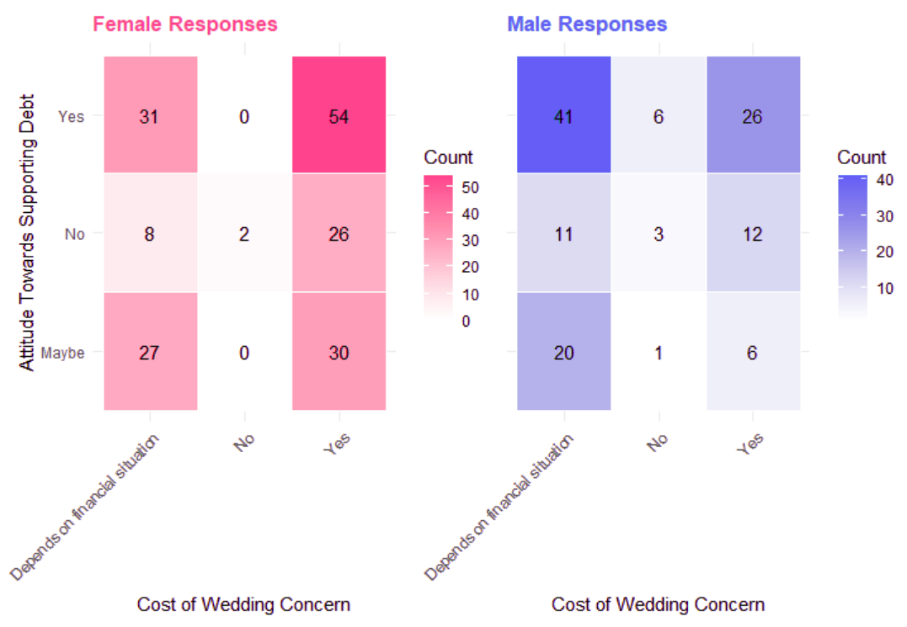
  Women’s support for debt is strongest when they feel financial pressure (concern about wedding cost).
  Men’s support for debt is strongest when they don’t feel financial pressure (no concern about cost).
  This suggests that:
1) Women may see debt as a necessary solution to a financial problem.
2)Men may view debt more as an acceptable or default approach, not necessarily tied to worry

Slide 16
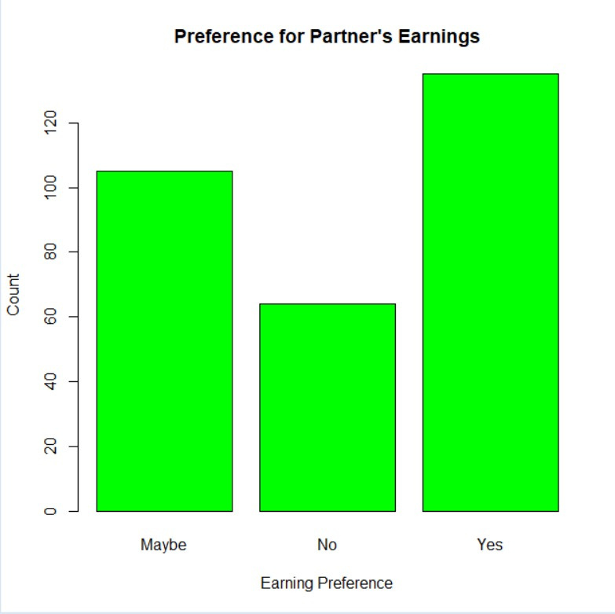
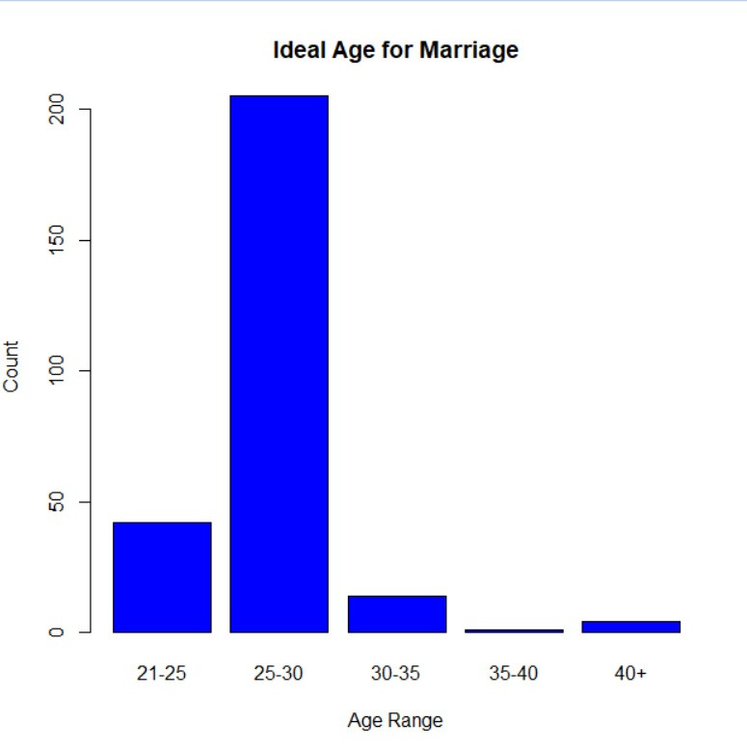
The data indicates that the majority of respondents consider the age group of 25–30 years as the most suitable for marriage, highlighting a societal preference for individuals to complete their education and establish early career stability before entering into marital commitments
The analysis shows that the majority of respondents prefer their partner to earn the same as themselves, which underscores a growing emphasis on balance, parity, and the avoidance of financial dependency in marital relationships.

Slide 17
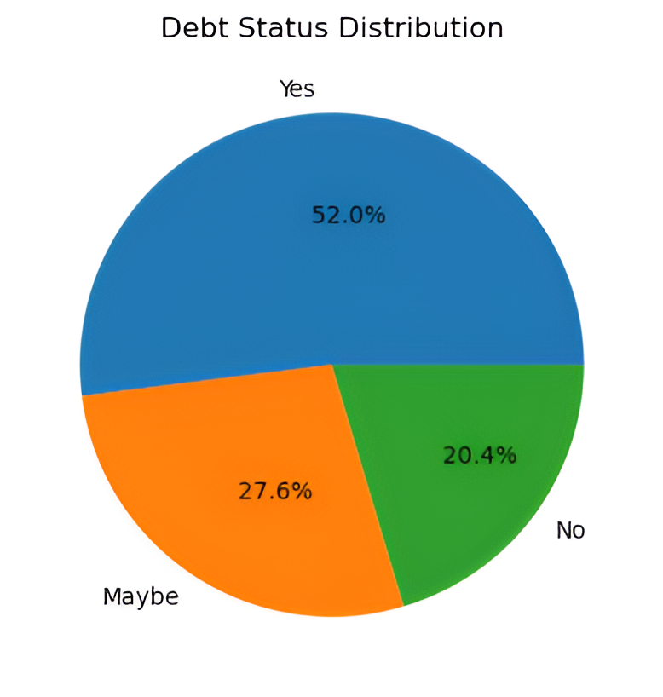
Over half of respondents 52% are comfortable with a Spouse having debt, while 27.6% are Uncertain and 20.4% are Opposed. This shows that debt plays an important role in marital decisions.

Slide 18
PROJECT CONCLUSIONS
70% Value Practicality with Love Compatibility & companionship matter more than romance alone
LOVE PLUS PRACTICALITY
1
2
3
FINANCIAL STABILITY FIRST
GENDER ROLE DIVIDE
80%Stress Financial Stability Most believe both partners must be financially secure before marriage.
Gender Roles Split
Men (60%) accept higher burden; women (65%) prefer 50/50 with added security.

Slide 19
PROJECT CONCLUSIONS
65% Support Financial Safeguards
Prenuptial agreements & property
protection gain strong approval.
FINANCIAL SAFE GUARDS
4
5
6
FREEDOM VS. PRESSURE
SECURITY WITH EQUALITY
55% Face Freedom vs Pressure Marriage seen as balancing autonomy with family/societal expectations.
75% Seek Security + Equality
Ideal marriage blends independence with shared responsibility.

Slide 20

REFERENCE
  Amato, P R.(2010). Research on divorce: Continuing trends and new developments. Journal of Marriage and Family, 72(3), 650-666.
  Kabeer, N. (1999), Resources, agency, achievements: Reflections on the measurement of women's empowerment. Derelopment and Change, 30(3), 435464.
  Desai, S., & Andrist, L.(2010), Gender scripts and age at marriage in India. Demography, 47(3), 667-687.

